Slide 1
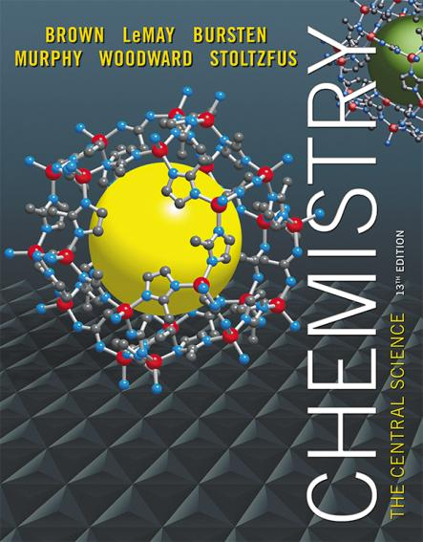
Chapter 13 Properties of Solutions
Lecture Presentation
.

Slide 2
Attractions Involved When Forming a Solution
Solute–solute interactions must be overcome to disperse these particles when making a solution.
Solvent–solvent interactions must be overcome to make room for the solute.
Solvent–solute interactions occur as the particles mix.

Slide 3
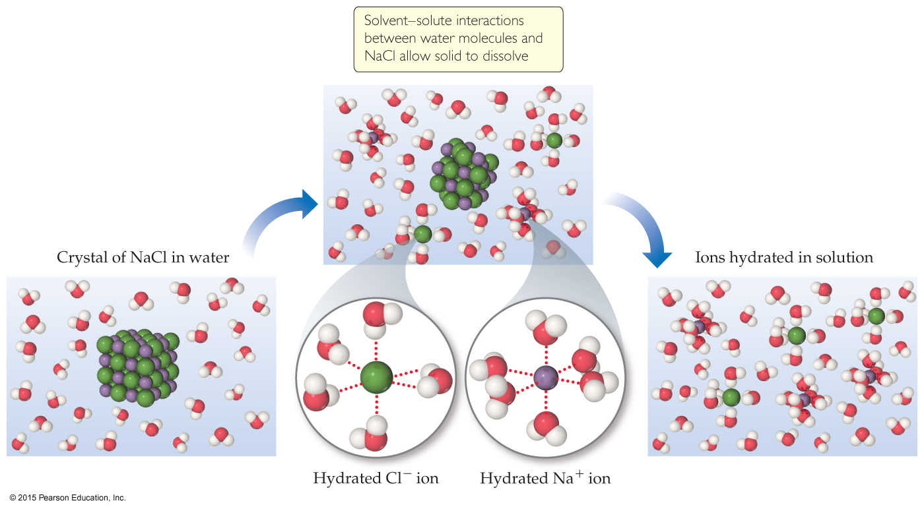
Energetics of Solution Formation

Slide 4
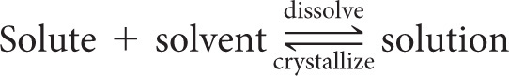
Opposing Processes
The solution-making process and crystallization are opposing processes.
When the rate of the opposing processes is equal, additional solute will not dissolve unless some crystallizes from solution. This is a saturated solution.
If we have not yet reached the amount that will result in crystallization, we have an unsaturated solution.

Slide 5
Solubility
Solubility is the maximum amount of solute that can dissolve in a given amount of solvent at a given temperature.
Saturated solutions have that amount of solute dissolved.
Unsaturated solutions have any amount of solute less than the maximum amount dissolved in solution.
Surprisingly, there is one more type of solution.

Slide 6
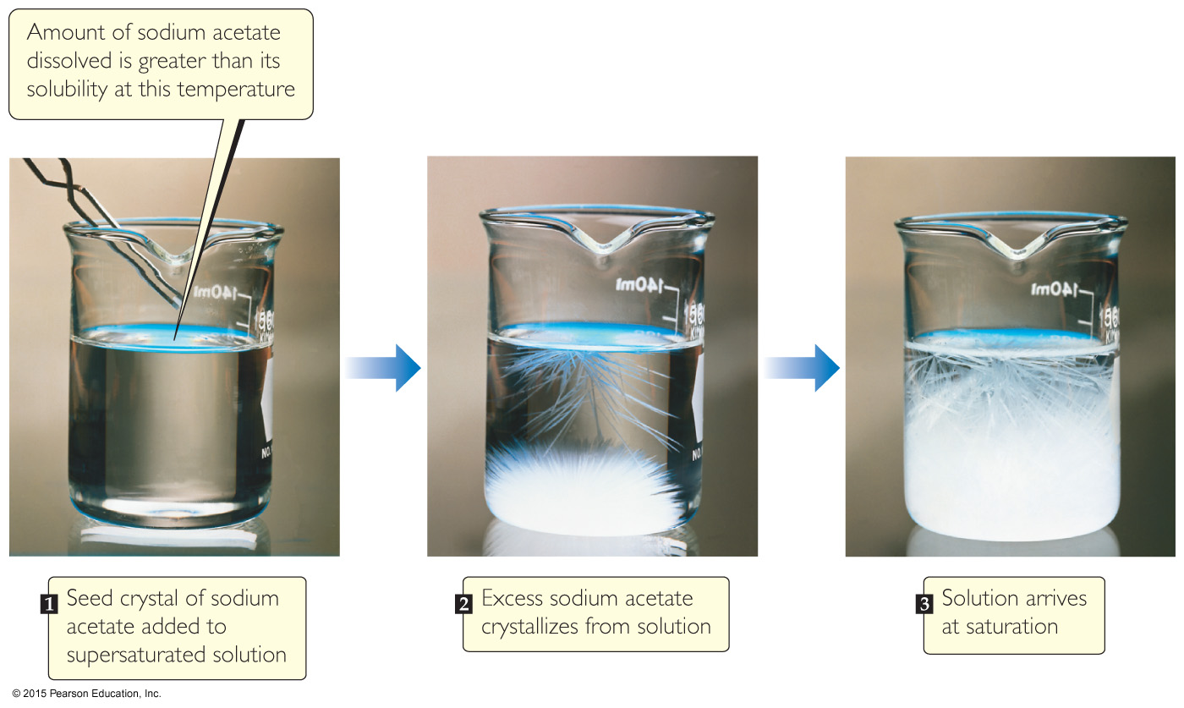
Supersaturated Solutions
In supersaturated solutions, the solvent holds more solute than is normally possible at that temperature.
These solutions are unstable; crystallization can usually be stimulated by adding a “seed crystal” or scratching the side of the flask.
These are uncommon solutions.

Slide 7
Factors That Affect Solubility
Solute–solvent Interactions
Pressure (for gaseous solutes)
Temperature

Slide 8
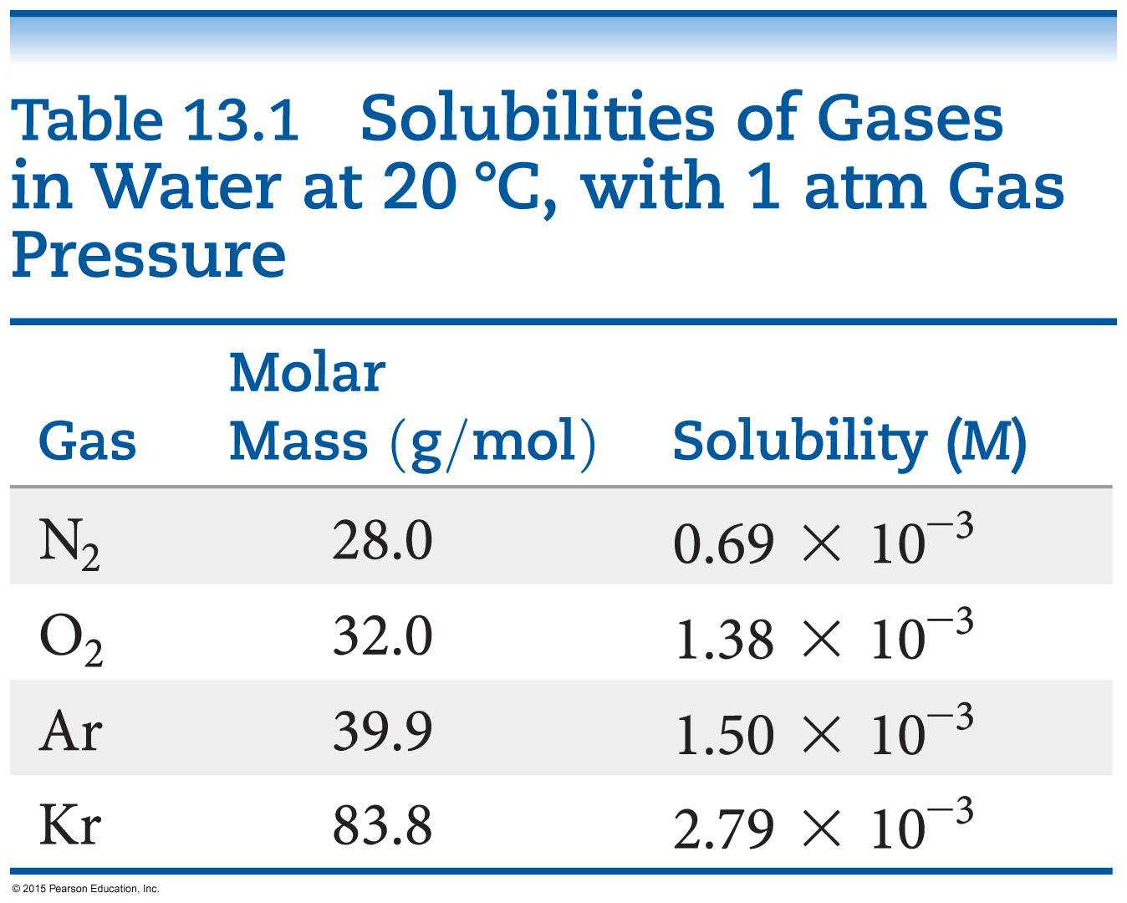
Solute–Solvent Interactions
Simply put: “Like dissolves like.”
That does not explain everything!
The stronger the solute–solvent interaction, the greater the solubility of a solute in that solvent.
The gases in the table only exhibit dispersion force. The larger the gas, the more soluble it will be in water.

Slide 9
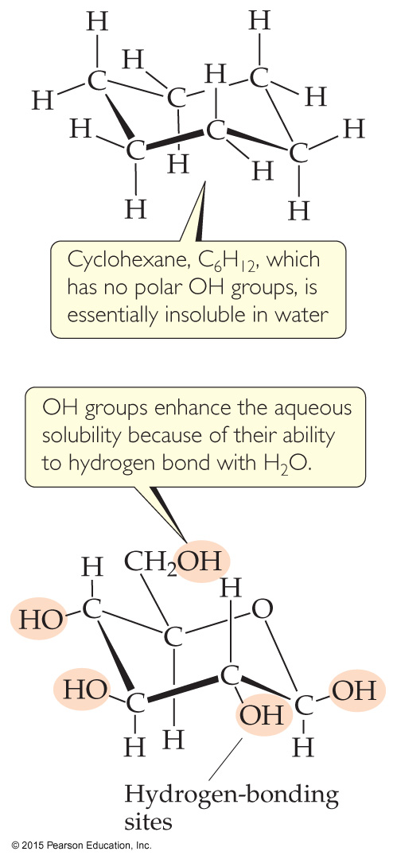
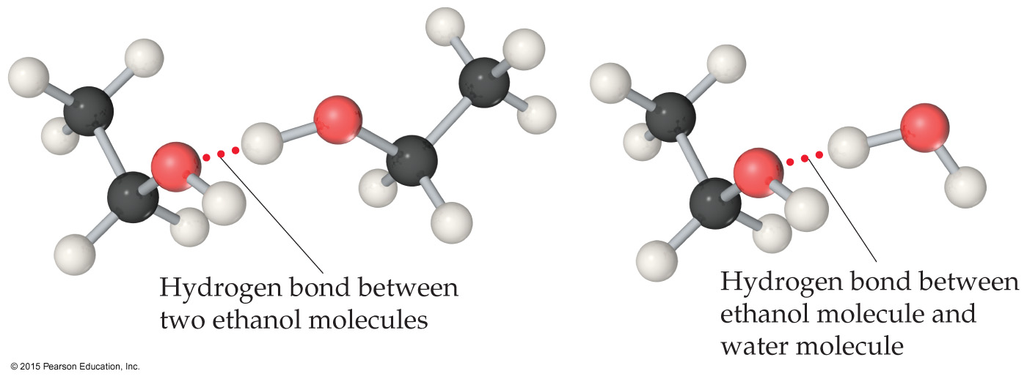
Organic Molecules in Water
Polar organic molecules dissolve in water better than nonpolar organic molecules.
Hydrogen bonding increases solubility, since C–C and C–H bonds are not very polar.

Slide 10
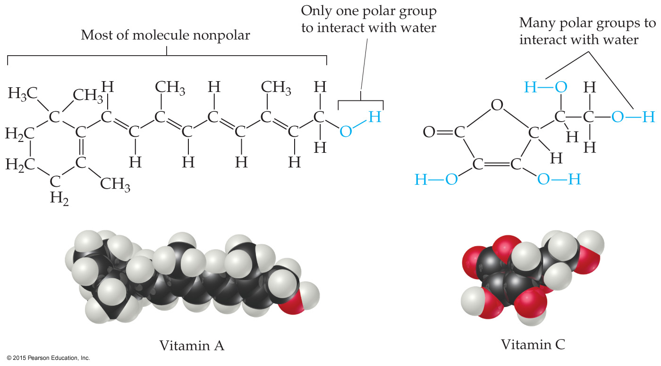
Solubility and Biological Importance
Fat-soluble vitamins (like vitamin A) are nonpolar; they are readily stored in fatty tissue in the body.
Water-soluble vitamins (like vitamin C) need to be included in the daily diet.

Slide 11
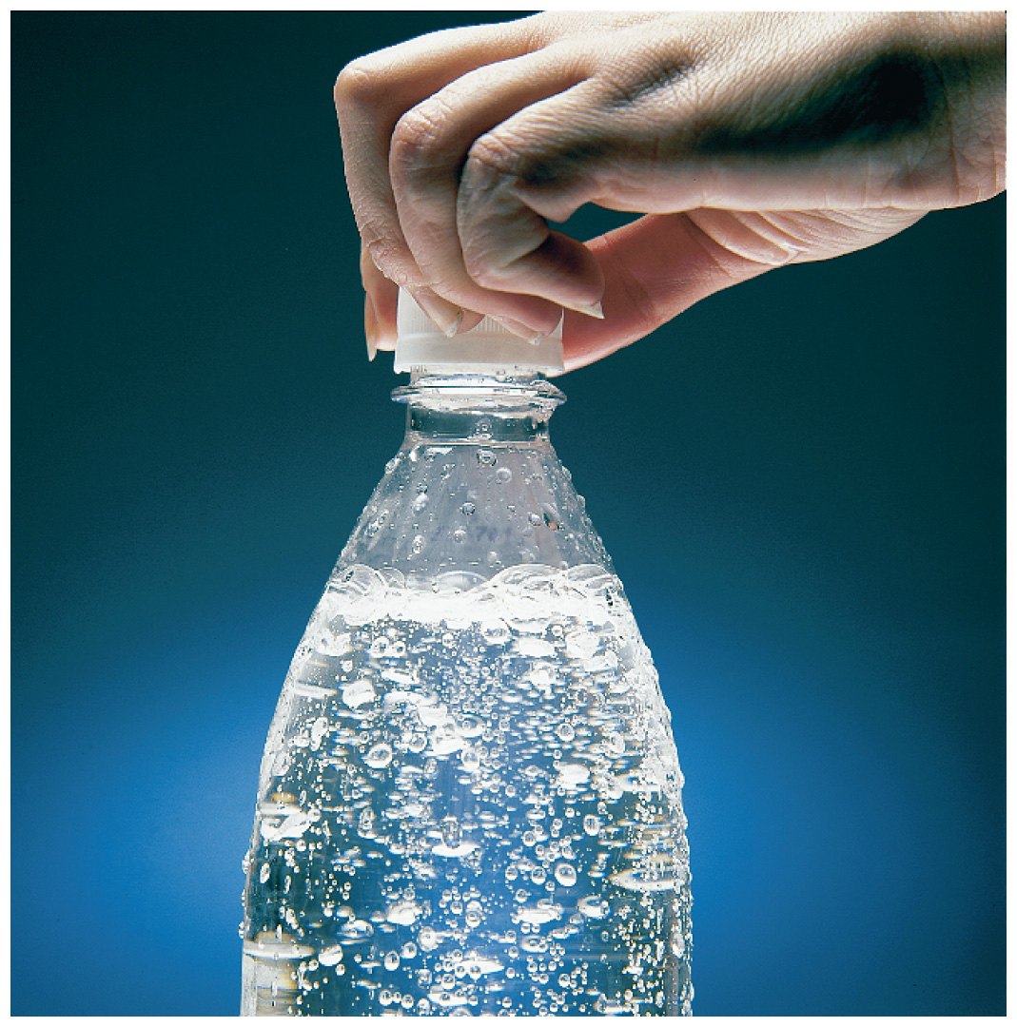
Pressure Effects
The solubility of solids and liquids are not appreciably affected by pressure.
Gas solubility is affected by pressure.

Slide 12
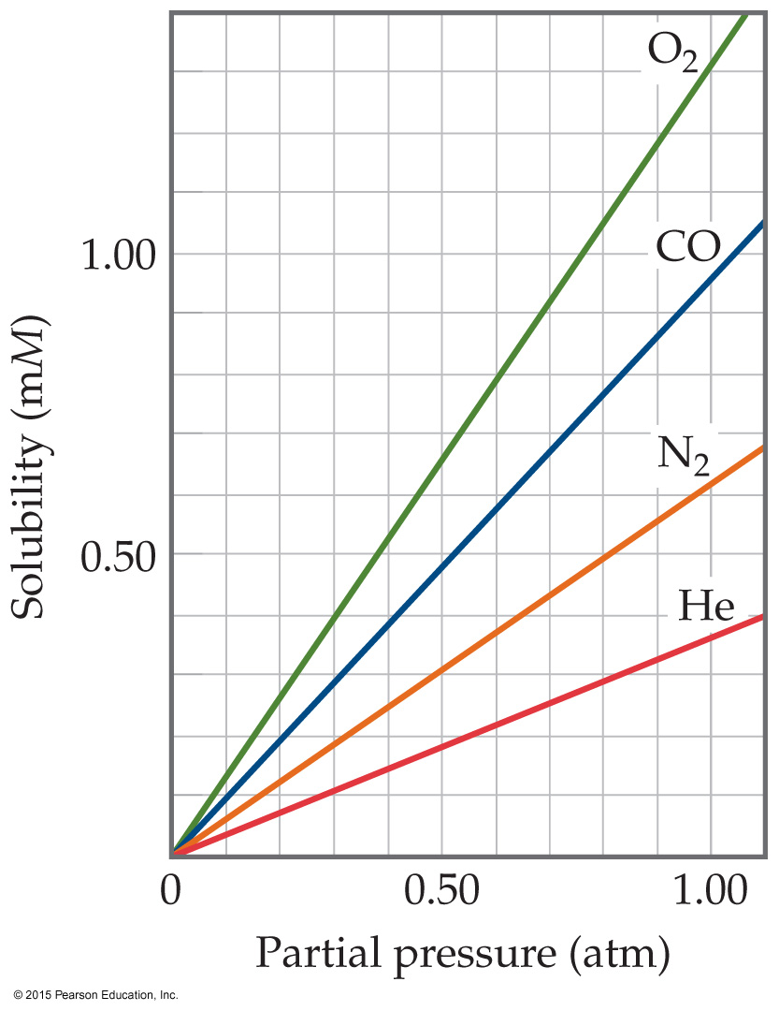
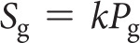
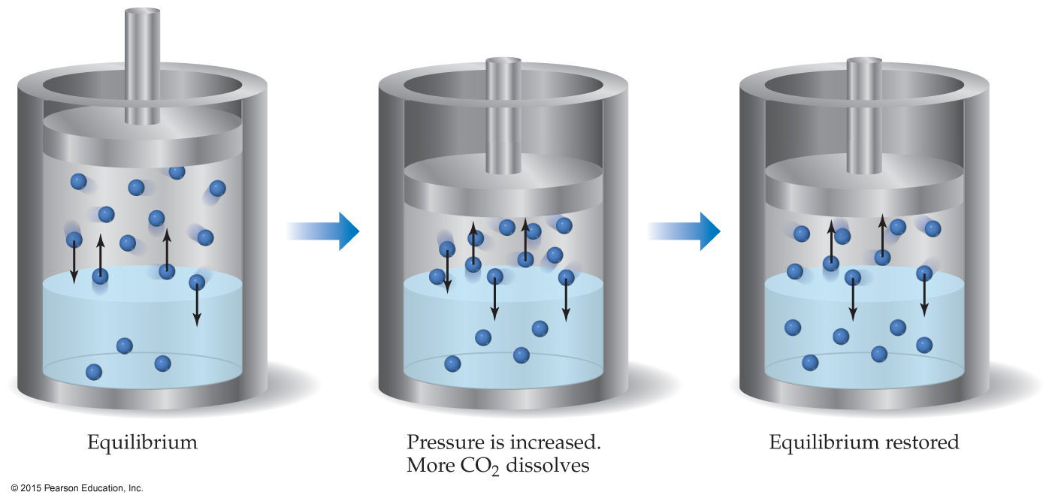
Henry’s Law
The solubility of a gas is proportional to the partial pressure of the gas above the solution.

Slide 13
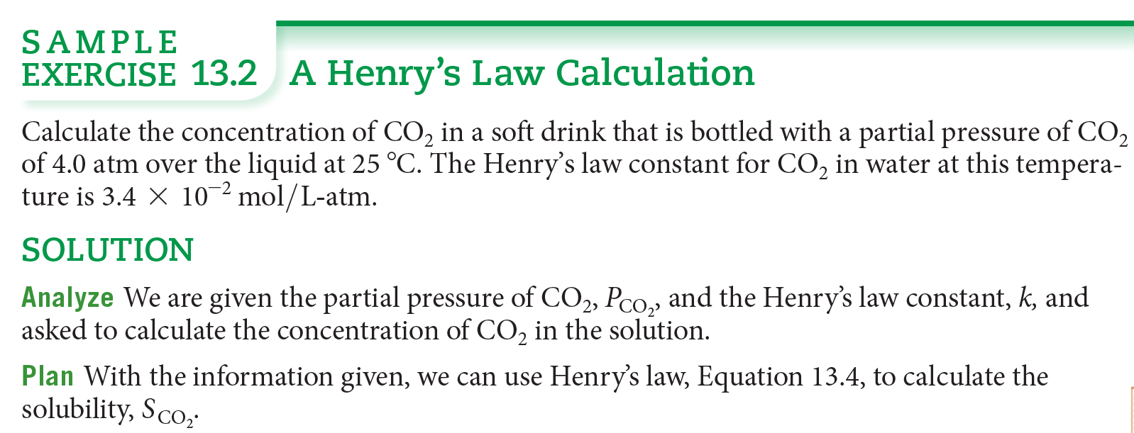
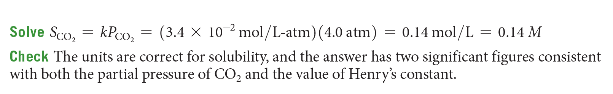

Slide 14
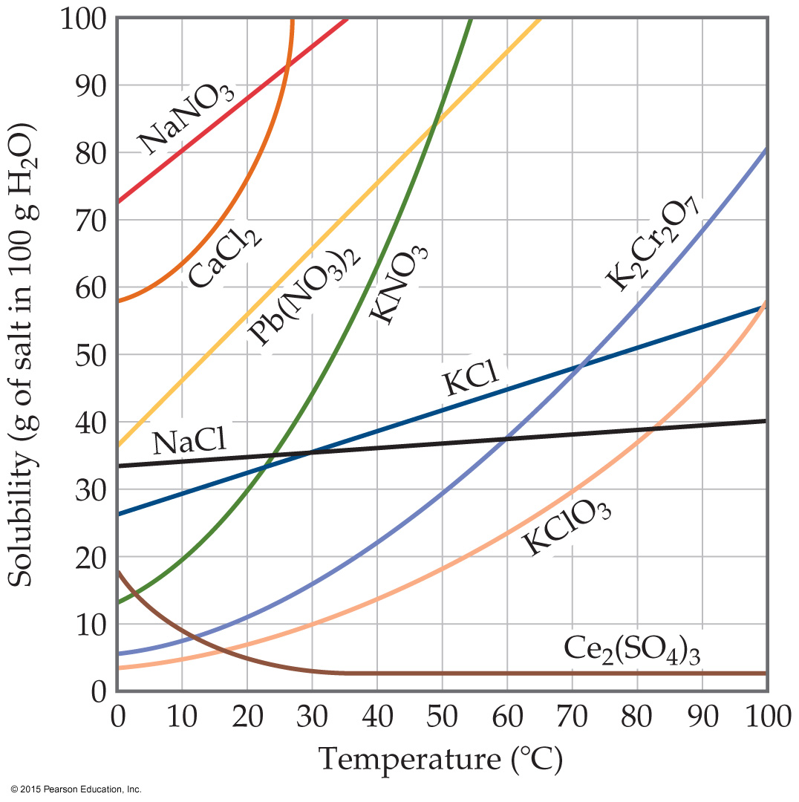
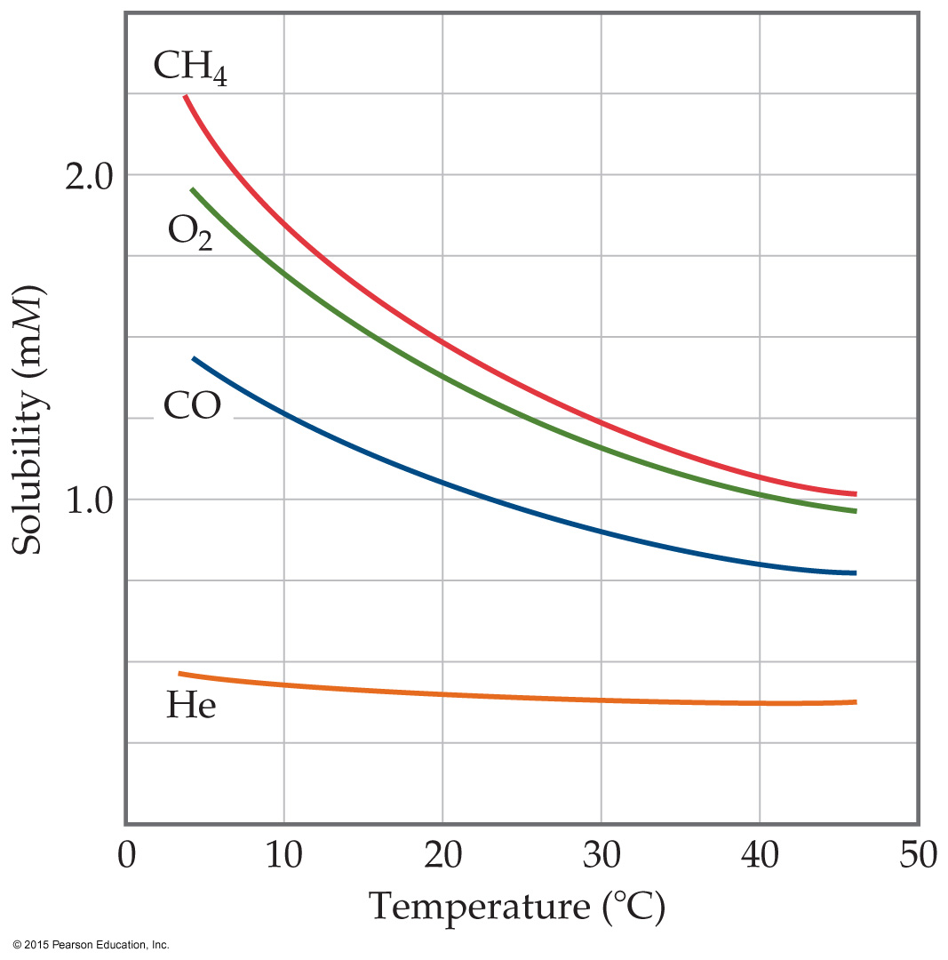
Temperature Effects
For most solids, as temperature increases, solubility increases. However, clearly this is not always true—some increase greatly, some remain relatively constant, and others decrease.
For all gases, as temperature increases, solubility decreases. Cold rivers have higher oxygen content than warm rivers.

Slide 15
2) Parts per Million (ppm) 3) Parts per Billion (ppb)
still relating mass of a solute to the total mass of the solution
Since percent is out of 100, we multiplied by 100.
ppm is per million, so we multiply by 10⁶.
ppb is per billion, so we multiply by 10⁹.

Slide 16
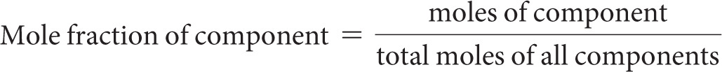
(4) Mole Fraction (χ)
Mole fraction is the ratio of moles of a substance to the total number of moles in a solution.
It does not matter if it is for a solute or for a solvent.

Slide 17
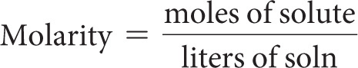
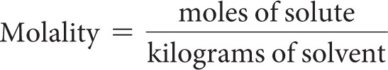
(5) Molarity (M) (6) Molality (m)
Be careful of your penmanship!
Molarity was discussed in Chapter 4 as moles of solute per liter of solution.
Molality is moles of solute per kilogram of solvent.

Slide 18
Colligative Properties
Colligative properties depend only on the quantity, not on the identity of the solute particles.
Among colligative properties are:
Vapor-pressure lowering
Boiling-point elevation
Freezing-point depression
Osmotic pressure

Slide 19
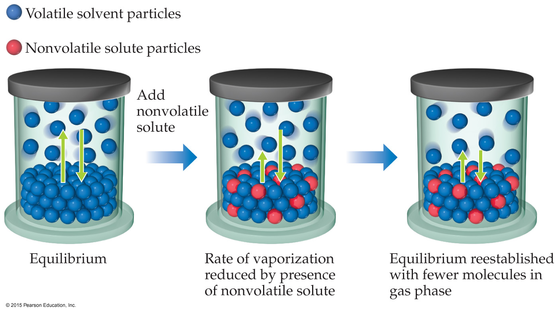
Vapor Pressure
Because of solute–solvent intermolecular attraction, higher concentrations of nonvolatile solutes make it harder for solvent to escape to the vapor phase. Therefore, the vapor pressure of a solution is lower than that of the pure solvent.

Slide 20
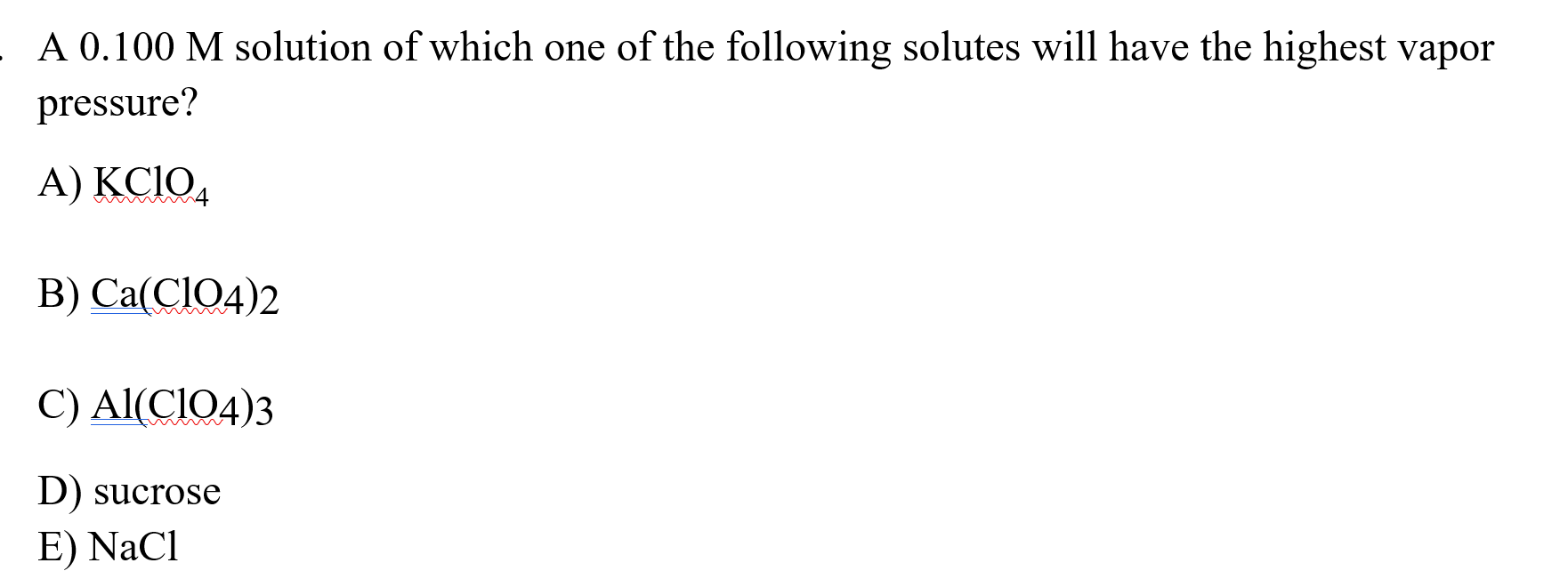
Assignment question

Slide 21
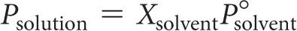
Raoult’s Law
The vapor pressure of a volatile solvent over the solution is the product of the mole fraction of the solvent times the vapor pressure of the pure solvent.
In ideal solutions, it is assumed that each substance will follow Raoult’s Law.

Slide 22
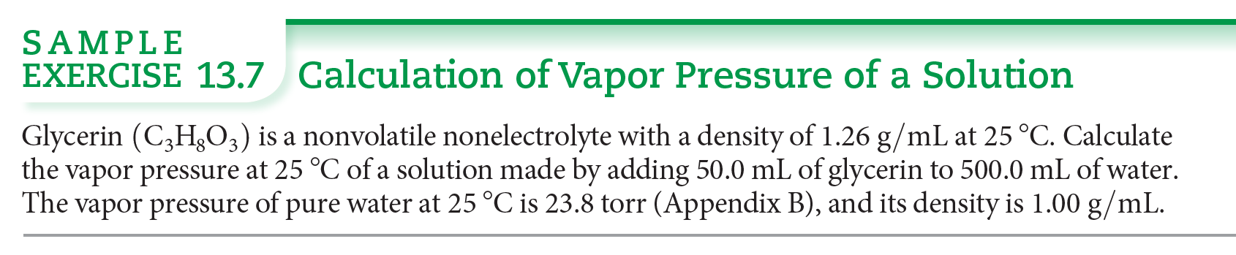
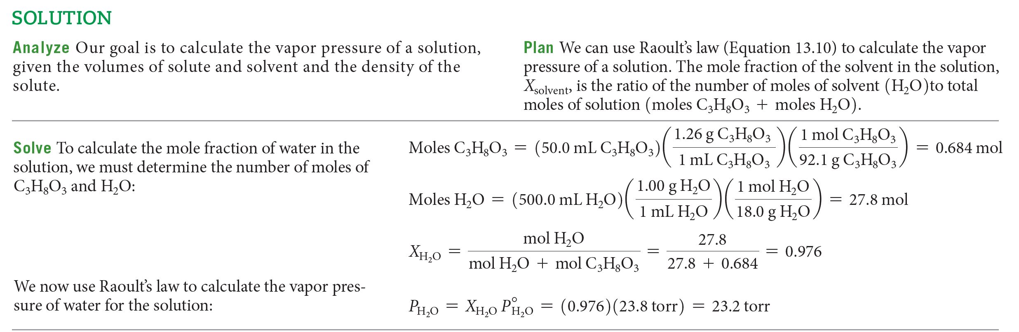

Slide 23
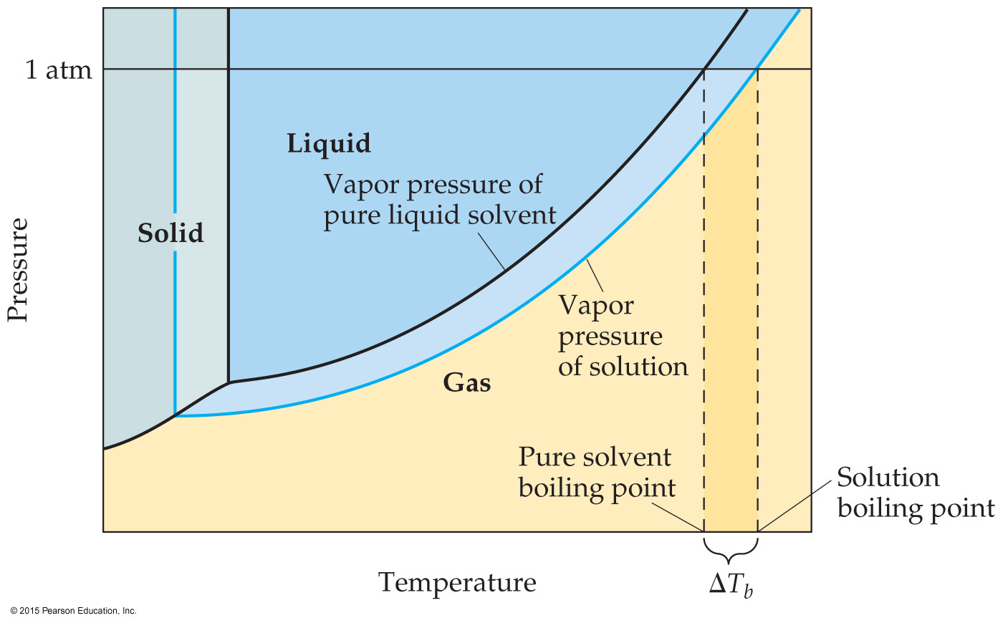
Boiling-Point Elevation
Since vapor pressures are lowered for solutions, it requires a higher temperature to reach atmospheric pressure. Hence, boiling point is raised.

Slide 24
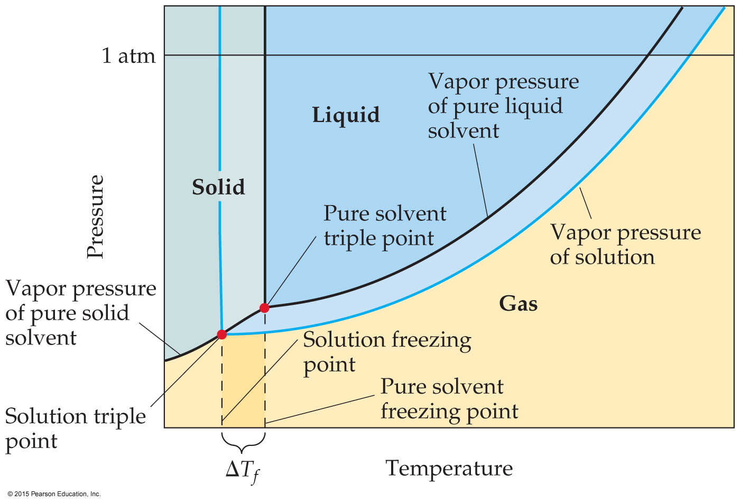
Freezing-Point Depression
The construction of the phase diagram for a solution demonstrates that the freezing point is lowered while the boiling point is raised.

Slide 25
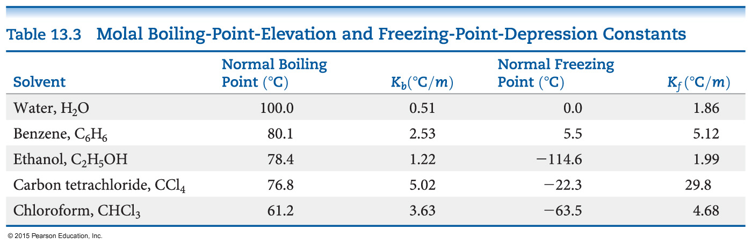
Boiling-Point Elevation and Freezing-Point Depression
The change in temperature is directly proportional to molality (using the van’t Hoff factor：i).

Slide 26
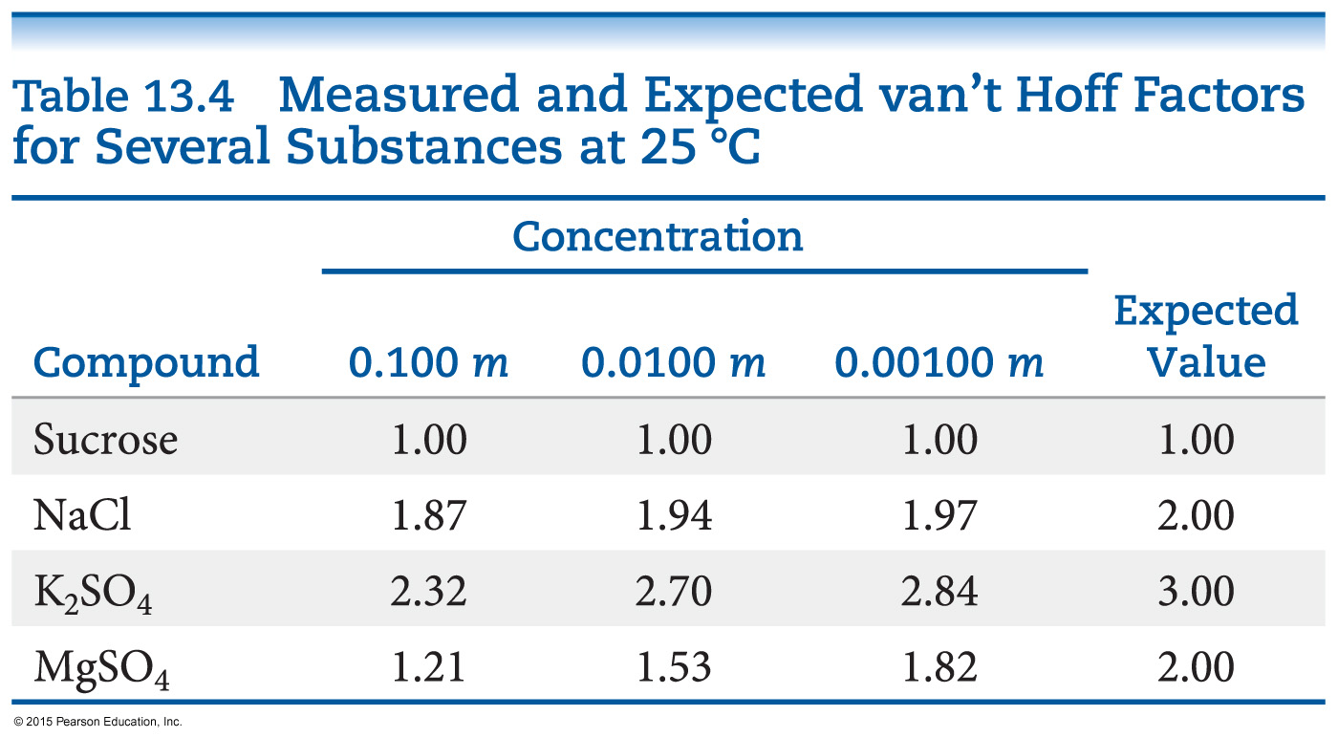
The van’t Hoff Factor (i)
What is the van’t Hoff factor?
It takes into account dissociation in solution!
Theoretically, we get 2 particles when NaCl dissociates. So, i = 2.
In fact, the amount that particles remain together is dependent on the concentration of the solution.

Slide 27
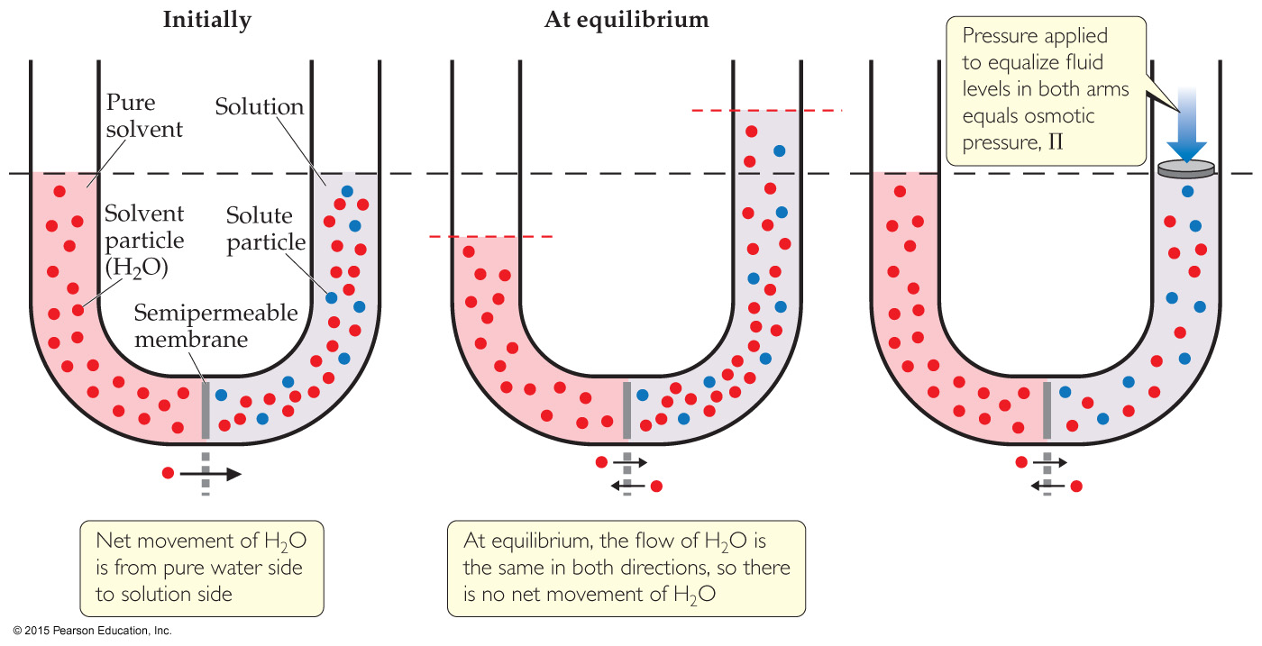
Osmosis
Some substances form semipermeable membranes, allowing some smaller particles to pass through, but blocking larger particles.
The net movement of solvent molecules from solution of low to high concentration across a semipermeable membrane is osmosis. The applied pressure to stop it is osmotic pressure.

Slide 28
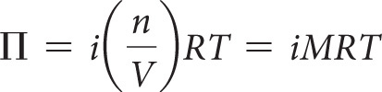
Osmotic Pressure
Osmotic pressure is a colligative property.
If two solutions separated by a semipermeable membrane have the same osmotic pressure, no osmosis will occur.

Slide 29
Types of Solutions & Osmosis
Isotonic solutions: Same osmotic pressure; solvent passes the membrane at the same rate both ways.
Hypotonic solution: Lower osmotic pressure; solvent will leave this solution at a higher rate than it enters with.
Hypertonic solution: Higher osmotic pressure; solvent will enter this solution at a higher rate than it leaves with.

Slide 30
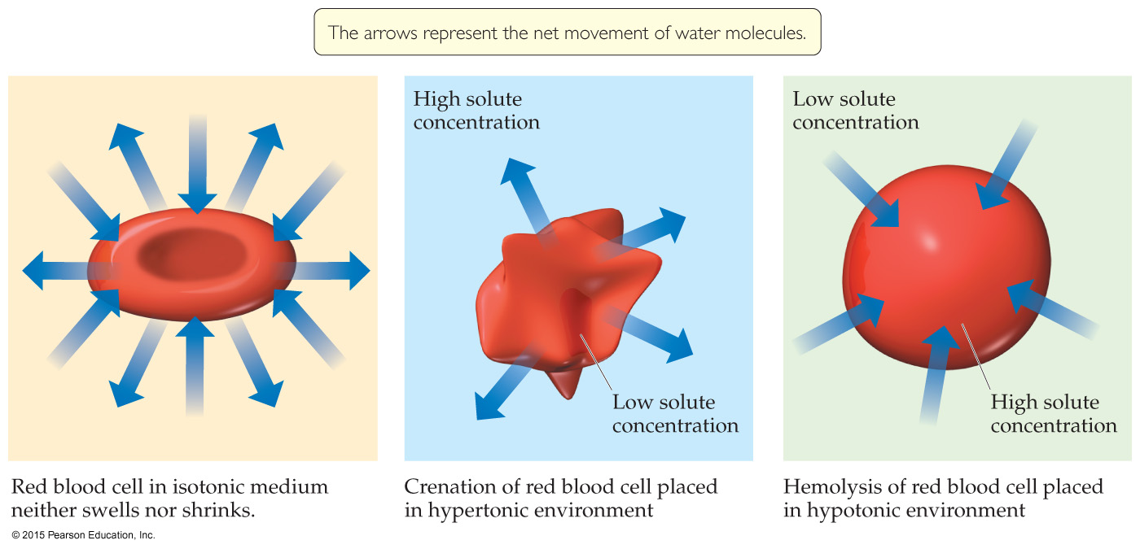
Osmosis and Blood Cells
Red blood cells have semipermeable membranes.
If stored in a hypertonic solution, they will shrivel as water leaves the cell; this is called crenation.
If stored in a hypotonic solution, they will grow until they burst; this is called hemolysis.

Slide 31
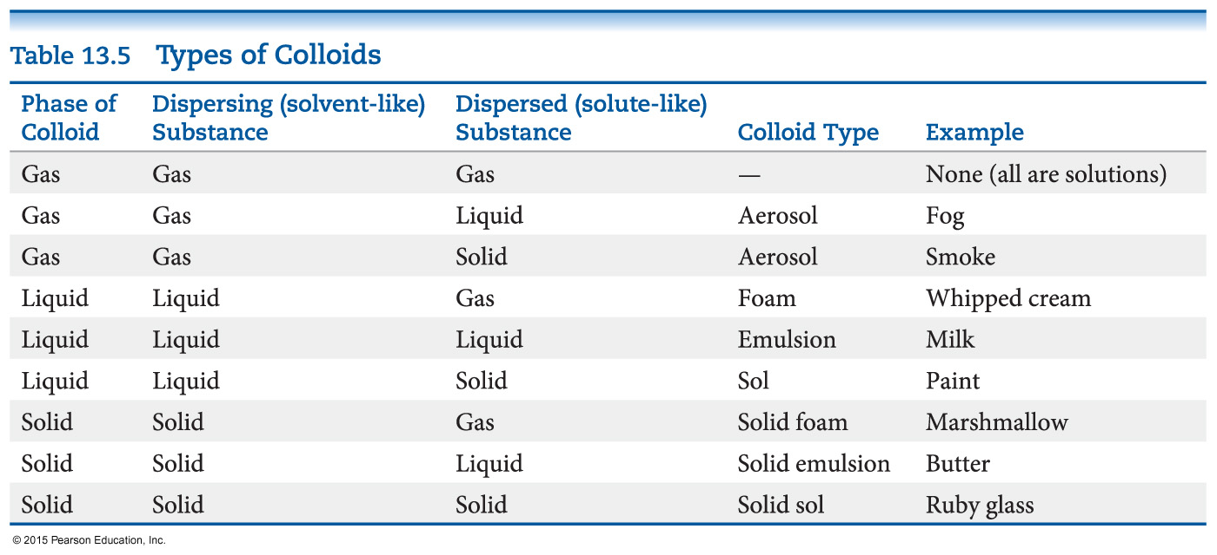
Colloids
Suspensions of particles larger than individual ions or molecules, but too small to be settled out by gravity, are called colloids.

Slide 32
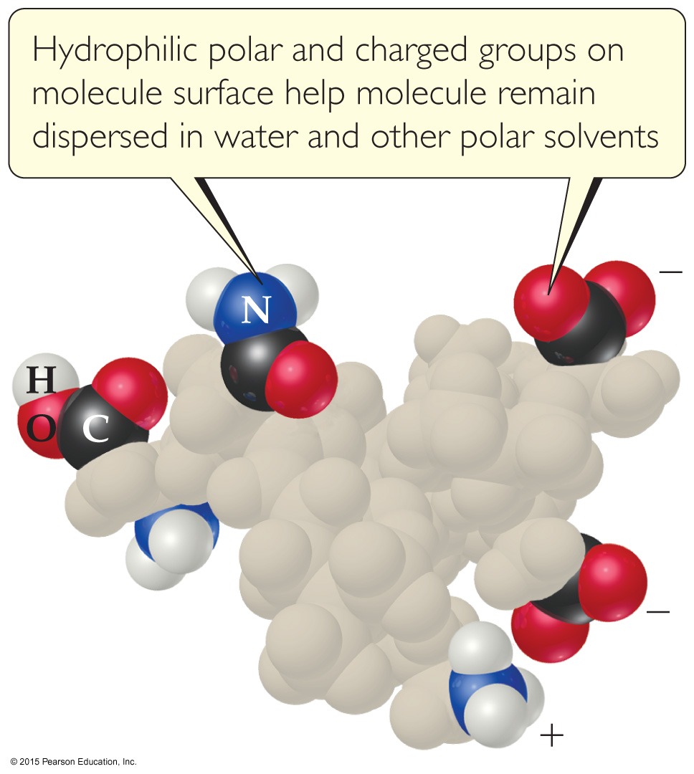
Colloids and Biomolecules
Some molecules have a polar, hydrophilic (water-loving) end and a nonpolar, hydrophobic (water-fearing) end.

Slide 33
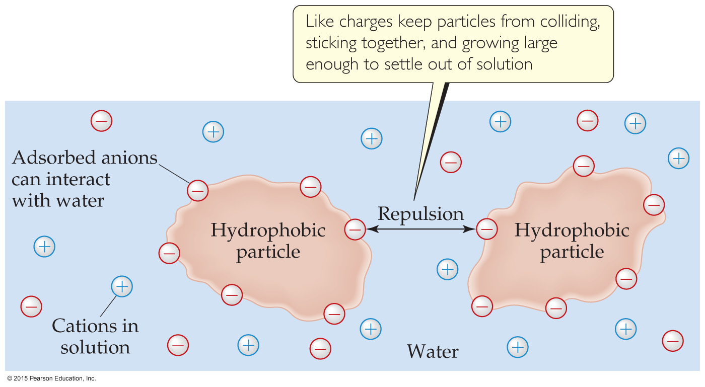
Stabilizing Colloids by Adsorption
Ions can adhere to the surface of an otherwise hydrophobic colloid.
This allows it to interact with aqueous solution.

Slide 34
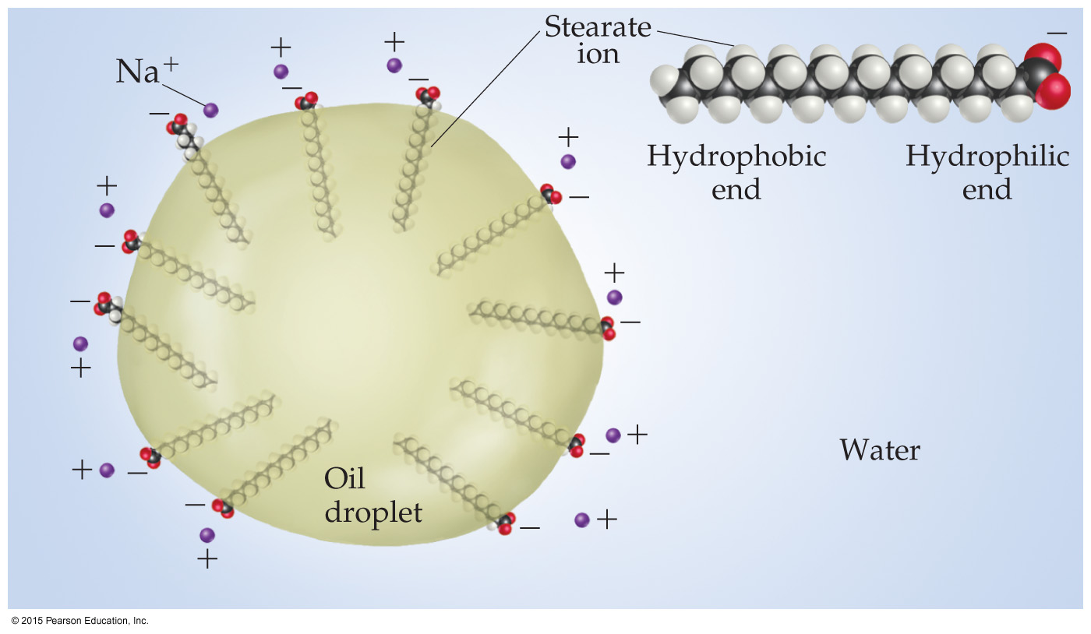
Colloids in Biological Systems
Colloids can aid in the emulsification of fats and oils in aqueous solutions.
An emulsifier causes something that normally does not dissolve in a solvent to do so.

Slide 35
Chapter 14 Chemical Kinetics
Lecture Presentation

Slide 36
Factors that Affect Reaction Rates
Physical state of the reactants
Reactant concentrations
Reaction temperature
Presence of a catalyst

Slide 37
Physical State of the Reactants
The more readily the reactants collide, the more rapidly they react.
Homogeneous reactions are often faster.
Heterogeneous reactions that involve solids are faster if the surface area is increased; i.e., a fine powder reacts faster than a pellet or tablet.

Slide 38
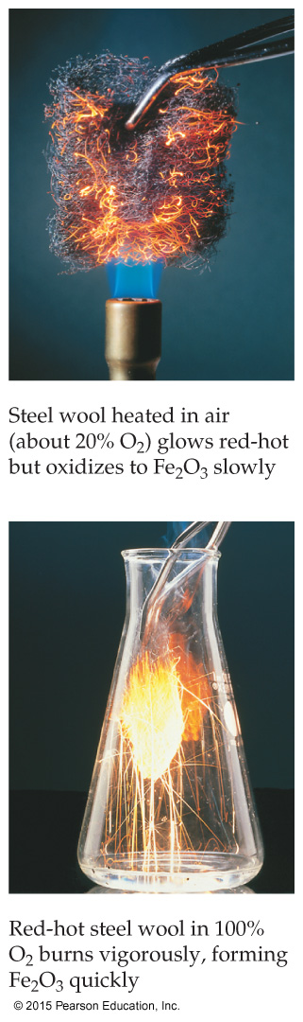
Reactant Concentrations
Increasing reactant concentration generally increases reaction rate.
Since there are more molecules, more collisions occur.

Slide 39
Temperature
Reaction rate generally increases with increased temperature.
Kinetic energy of molecules is related to temperature.
At higher temperatures, molecules move more quickly, increasing numbers of collisions and the energy the molecules possess during the collisions.

Slide 40
Presence of a Catalyst
Catalysts affect rate without being in the overall balanced equation.
Catalysts affect the kinds of collisions, changing the mechanism (individual reactions that are part of the pathway from reactants to products).
Catalysts are critical in many biological reactions.

Slide 41
Reaction Rate
Rate is a change in concentration over a time period: Δ[ ]/Δt.
Δ means “change in.”
[ ] means molar concentration.
t represents time.
Types of rate measured:
average rate
instantaneous rate
initial rate

Slide 42
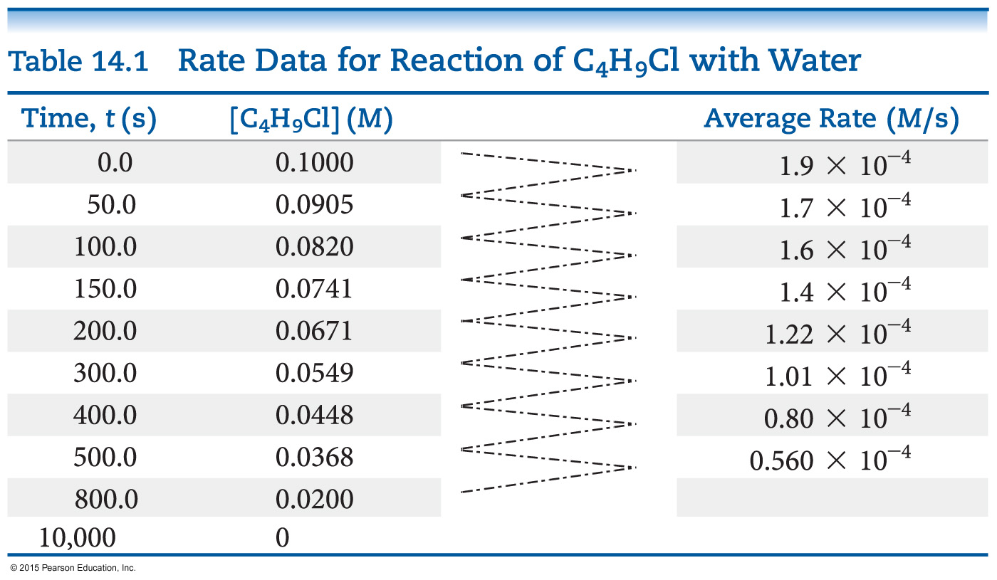
Following Reaction Rates
Rate of a reaction is measured using the concentration of a reactant or a product over time.
In this example, [C₄H₉Cl] is followed.

Slide 43
Following Reaction Rates
The average rate is calculated by the –(change in [C₄H₉Cl]) ÷ (change in time).
The table shows the average rate for a variety of time intervals.

Slide 44
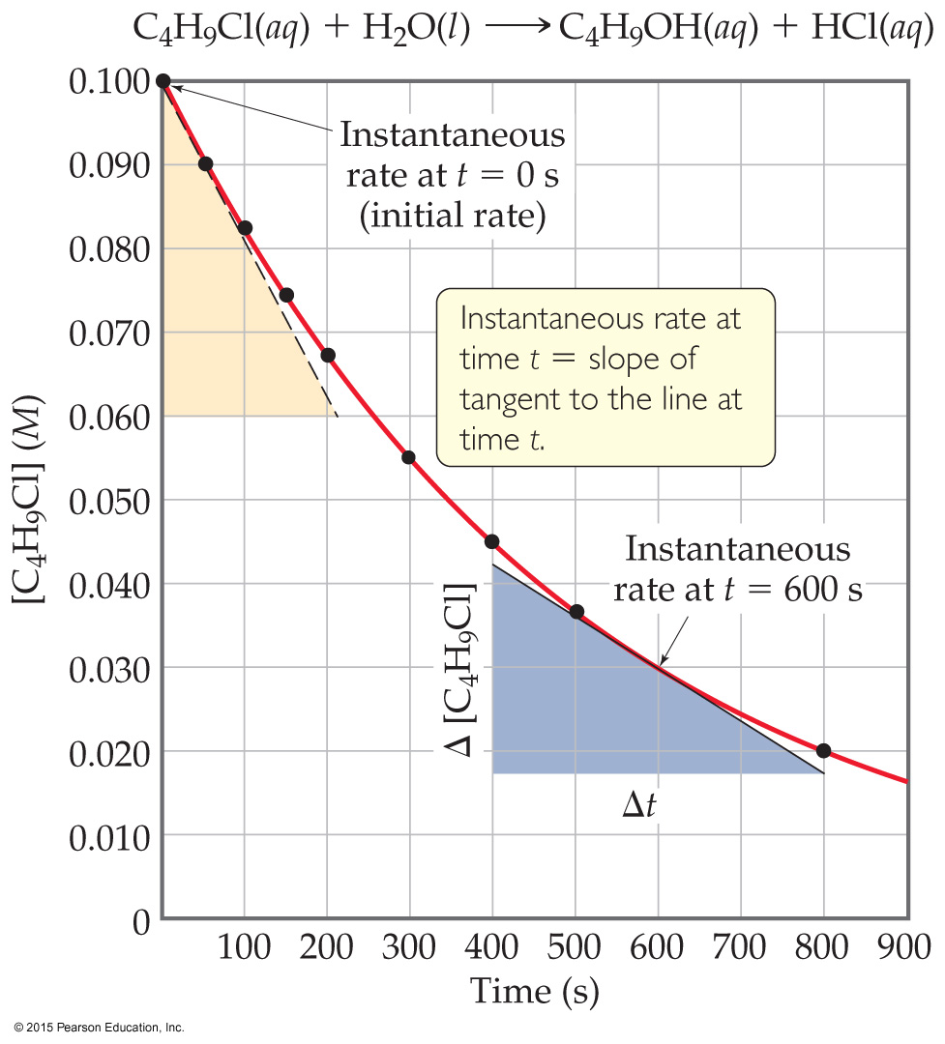
Plotting Rate Data
A plot of the data gives more information about rate.
The slope of the curve at one point in time gives the instantaneous rate.
The instantaneous rate at time zero is called the initial rate; this is often the rate of interest to chemists.
This figure shows instantaneous and initial rate of the earlier example.
Note: Reactions typically slow down over time!

Slide 45
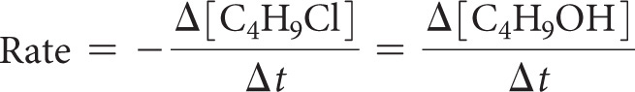
Relative Rates
As was said, rates are followed using a reactant or a product. Does this give the same rate for each reactant and product?
Rate is dependent on stoichiometry.
If we followed use of C₄H₉Cl and compared it to production of C₄H₉OH, the values would be the same. Note that the change would have opposite signs—one goes down in value, the other goes up.

Slide 46
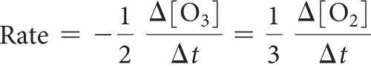
Relative Rates and Stoichiometry
What if the equation is not 1:1?
What will the relative rates be for:
2 O₃ (g) → 3 O₂ (g)

Slide 47
Determining Concentration Effect on Rate
How do we determine what effect the concentration of each reactant has on the rate of the reaction?
We keep every concentration constant except for one reactant and see what happens to the rate. Then, we change a different reactant. We do this until we have seen how each reactant has affected the rate.

Slide 48
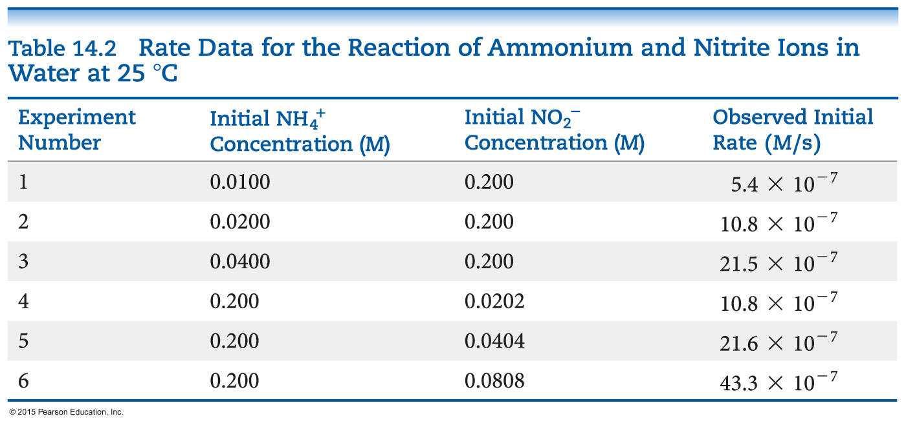
An Example of How Concentration Affects Rate
Experiments 1–3 show how [NH₄⁺] affects rate.
Experiments 4–6 show how [NO₂⁻] affects rate.
Result: The rate law, which shows the relationship between rate and concentration for all reactants:
Rate = k [NH₄⁺] [NO₂⁻]

Slide 49
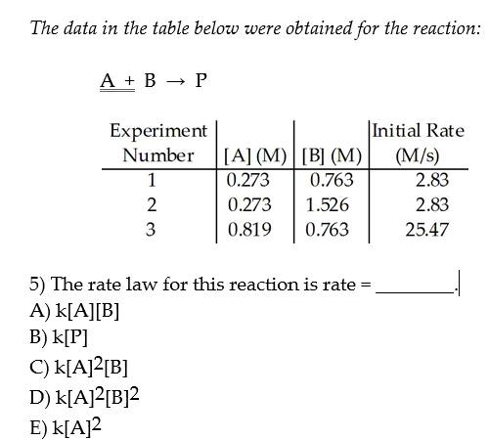

Slide 50
More about Rate Law
The exponents tell the order of the reaction with respect to each reactant.
In our example from the last slide:
Rate = k [NH₄⁺]^{m} [NO₂⁻]^{n}
The order with respect to each reactant is 1. (It is first order in NH₄⁺ and NO₂⁻.)
The reaction is second order (1 + 1 = 2; we just add up all of the reactants’ orders to get the reaction’s order).
What is k? It is the rate constant. It is a temperature-dependent quantity.

Slide 51
First Order Reactions
Some rates depend only on one reactant to the first power.
These are first order reactions.
The rate law becomes:
Rate = k [A]

Slide 52
Relating k to [A] in a First Order Reaction
rate = k [A]
rate = −Δ [A] / Δt
So: k [A] = −Δ [A] / Δt
Rearrange to: Δ [A] / [A] = − k Δt
Integrate: ln ([A] / [A]_{o}) = − k t
Rearrange: ln [A] = − k t + ln [A]_{o}
Note: this follows the equation of a line: y = m x + b
So, a plot of ln [A] vs. t is linear.

Slide 53
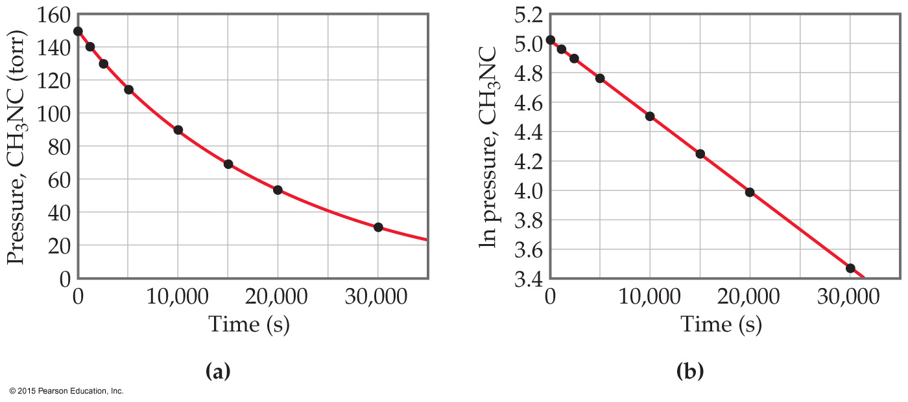
An Example: Conversion of Methyl Isonitrile to Acetonitrile
The equation for the reaction:
CH₃NC → CH₃CN
It is first order.
Rate = k [CH₃NC]

Slide 54
Finding the Rate Constant, k
Besides using the rate law, we can find the rate constant from the plot of ln [A] vs. t.
Remember the integrated rate law:
ln [A] = − k t + ln [A]_{o}
The plot will give a line. Its slope will equal −k.

Slide 55
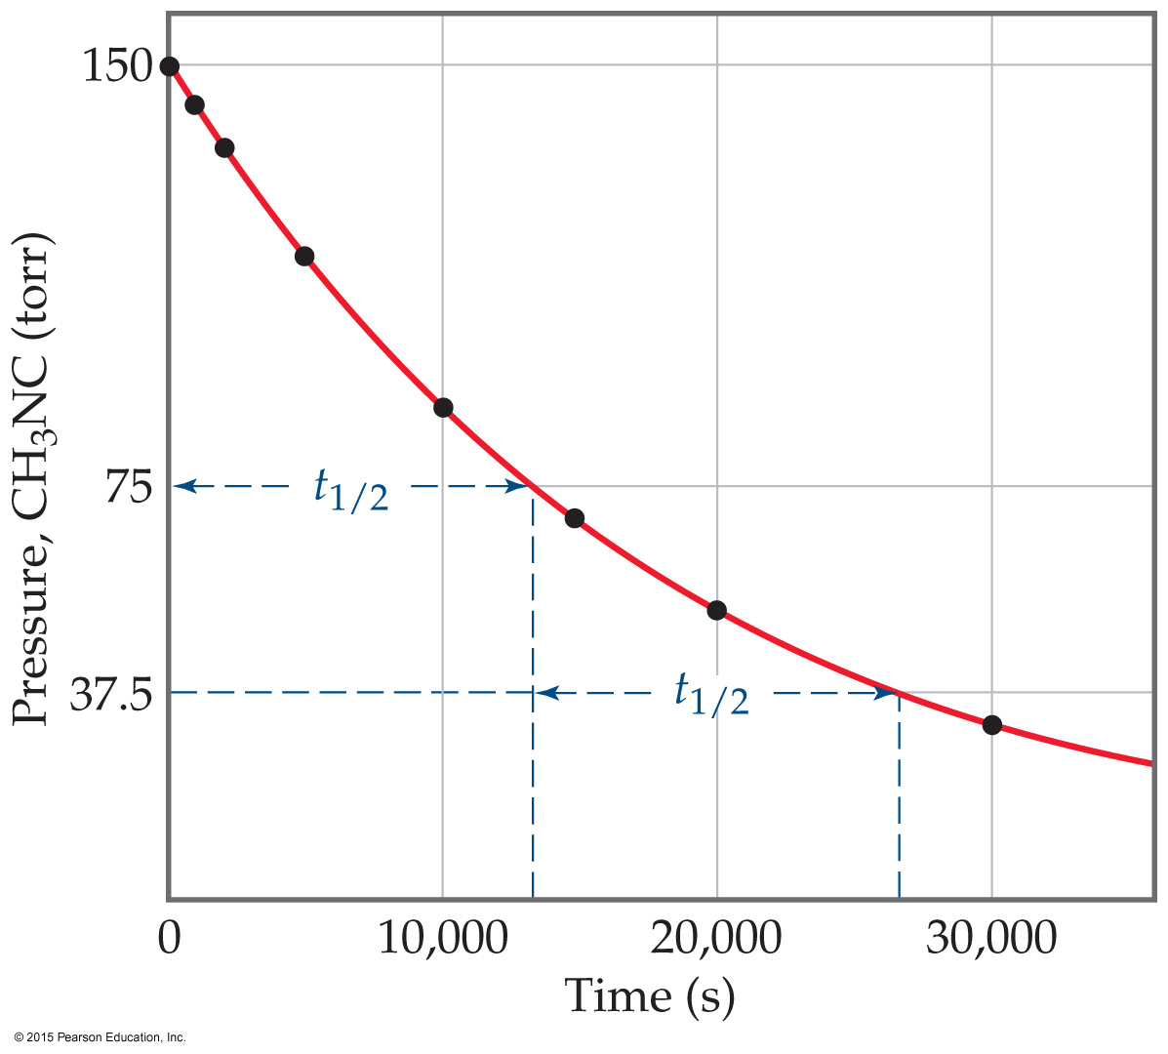
Half-life
Definition: The amount of time it takes for one-half of a reactant to be used up in a chemical reaction.
First Order Reaction:
ln [A] = − k t + ln [A]_{o}
ln ([A]_{o}/2) = − k t_{½} + ln [A]_{o}
− ln ([A]_{o}/2) + ln [A]_{o} = k t_{½}
ln ([A]_{o} / [A]_{o}/2) = k t_{½}
ln 2 = k t_{½} or t_{½} = 0.693/k

Slide 56
Second Order Reactions
Some rates depend only on a reactant to the second power.
These are second order reactions.
The rate law becomes:
Rate = k [A]²

Slide 57
Solving the Second Order Reaction for A → Products
rate = k [A]²
rate = − Δ [A] / Δ t
So, k [A]² = − Δ [A] / Δ t
Rearranging: Δ [A] / [A]² = − k Δ t
Using calculus: 1/[A] = 1/[A]_{o} + k t
Notice: The linear relationships for first order and second order reactions differ!

Slide 58
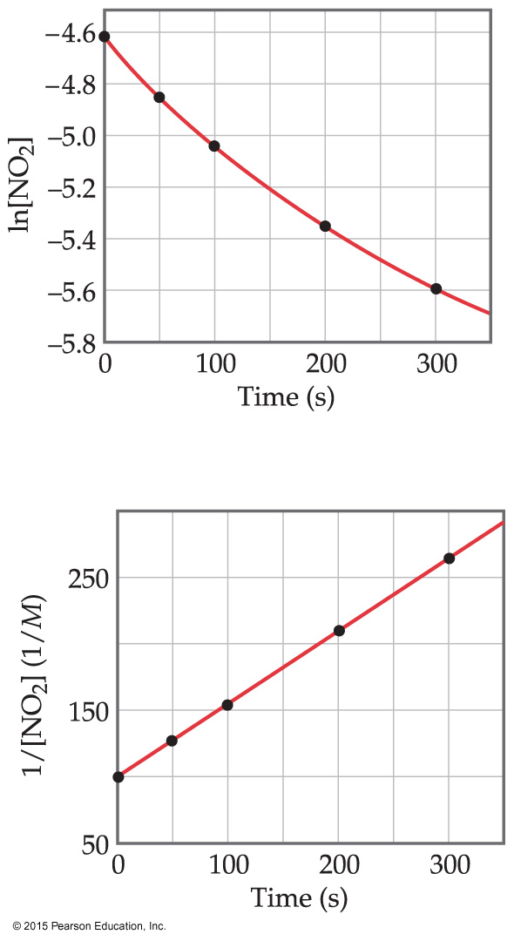
An Example of a Second Order Reaction: Decomposition of NO₂
A plot following NO₂ decomposition shows that it must be second order because it is linear for 1/[NO₂], not linear for ln [NO₂].
Equation:
NO₂ → NO + ½ O₂

Slide 59
Half-Life and Second Order Reactions
Using the integrated rate law, we can see how half-life is derived:
1/[A] = 1/[A]_{o} + k t
1/([A]_{o}/2) = 1/[A]_{o} + k t_{½}
2/[A]_{o} −1/[A]_{o} = k t_{½}
t_{½} = 1 / (k [A]_{o})
So, half-life is a concentration dependent quantity for second order reactions!

Slide 60
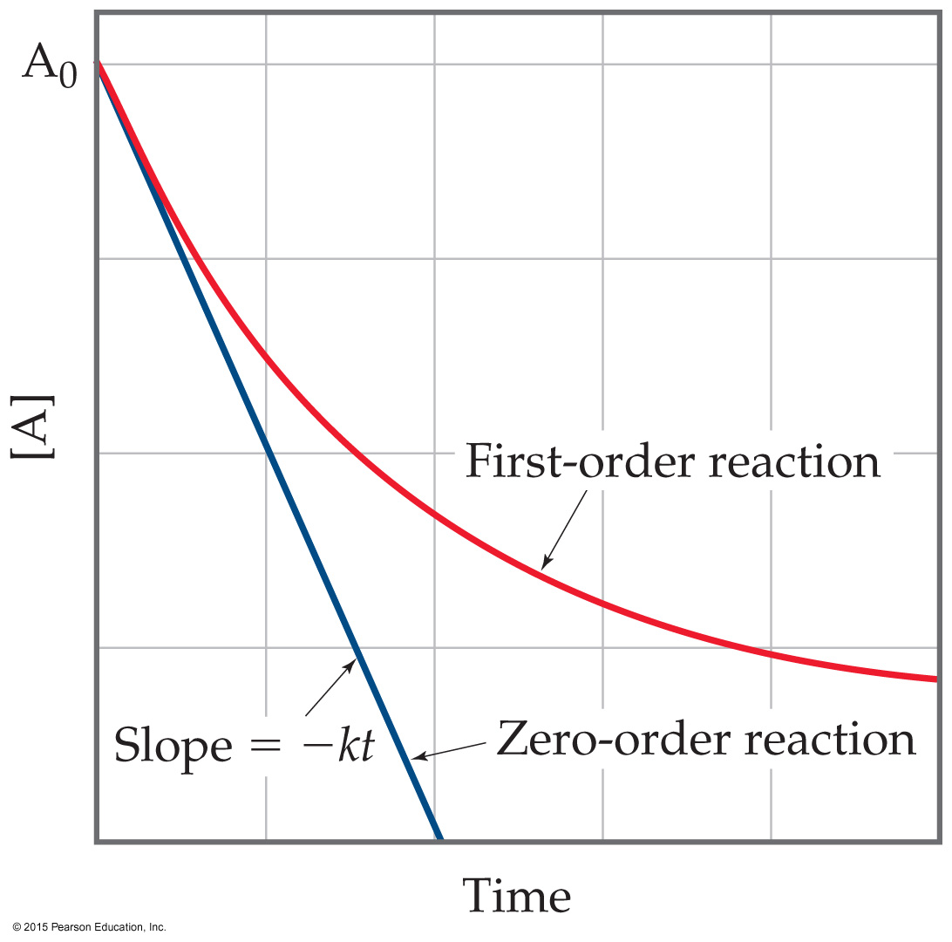
Zero Order Reactions
Occasionally, rate is independent of the concentration of the reactant:
Rate = k
These are zero order reactions.
These reactions are linear in concentration.

Slide 61
Factors That Affect Reaction Rate
Temperature
Frequency of collisions
Orientation of molecules
Energy needed for the reaction to take place (activation energy)

Slide 62
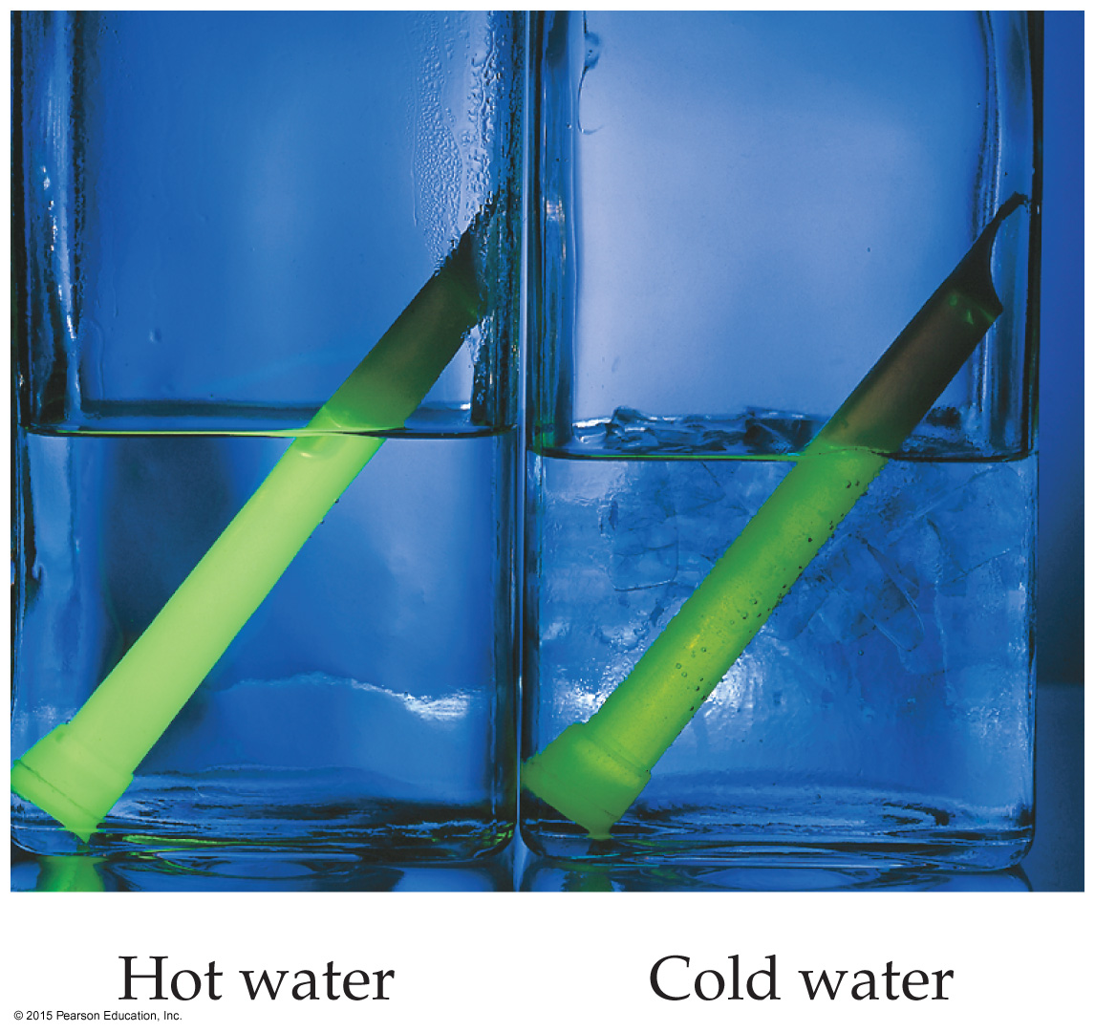
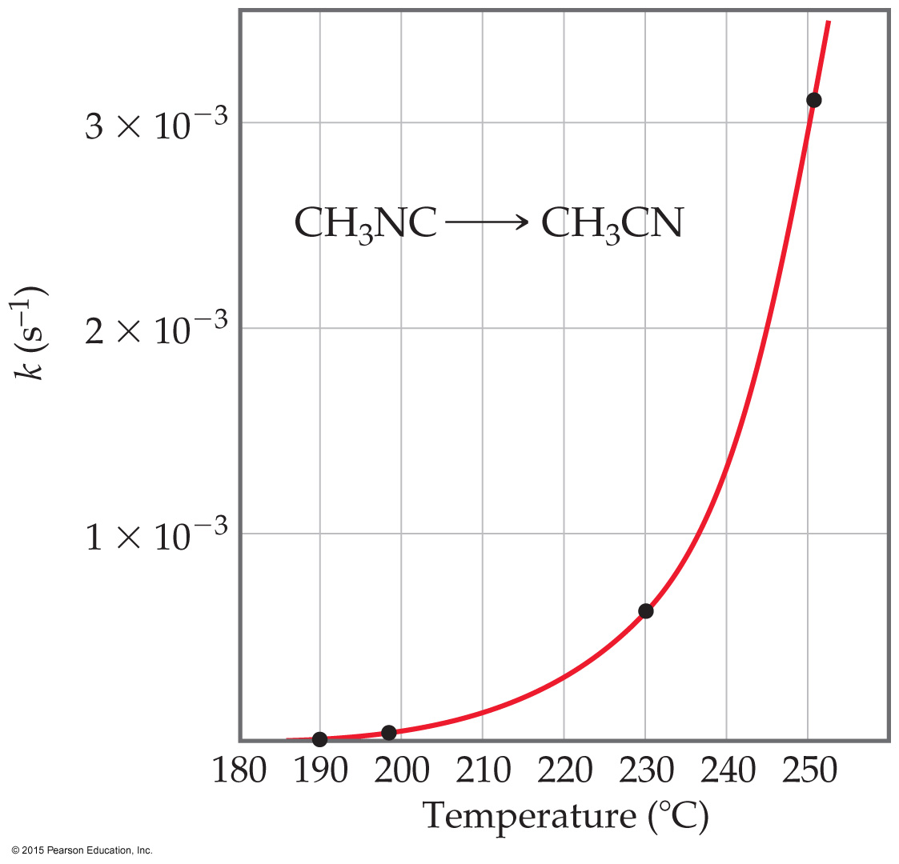
Temperature and Rate
Generally, as temperature increases, rate increases.
The rate constant is temperature dependent: it increases as temperature increases.
Rate constant doubles (approximately) with every 10 ºC rise.

Slide 63
Frequency of Collisions
The collision model is based on the kinetic molecular theory.
Molecules must collide to react.
If there are more collisions, more reactions can occur.
So, if there are more molecules, the reaction rate is faster.
Also, if the temperature is higher, molecules move faster, causing more collisions and a higher rate of reaction.

Slide 64
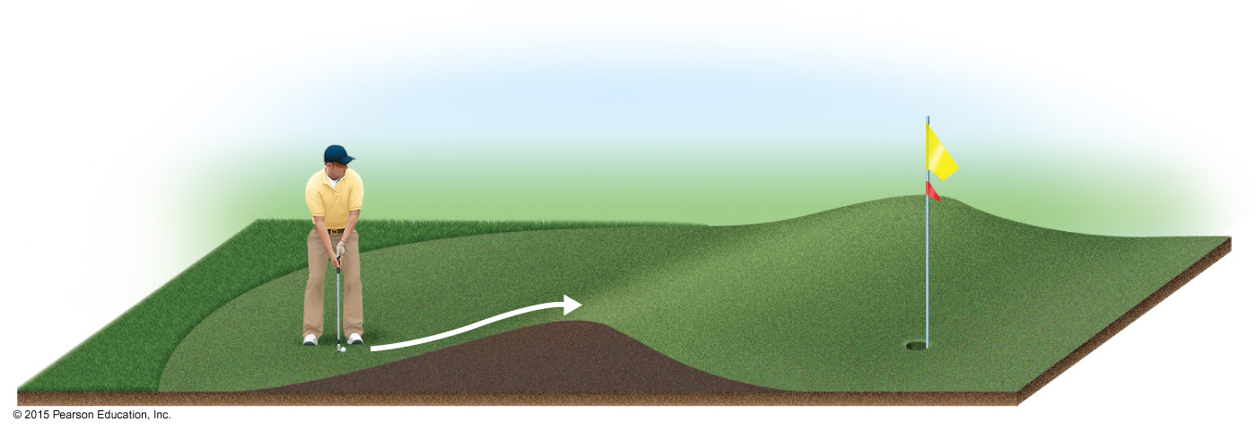
Energy Needed for a Reaction to Take Place (Activation Energy)
The minimum energy needed for a reaction to take place is called activation energy.
An energy barrier must be overcome for a reaction to take place, much like the ball must be hit to overcome the barrier in the figure below.

Slide 65
Transition State (Activated Complex)
Reactants gain energy as the reaction proceeds until the particles reach the maximum energy state.
The organization of the atoms at this highest energy state is called the transition state (or activated complex).
The energy needed to form this state is called the activation energy.

Slide 66
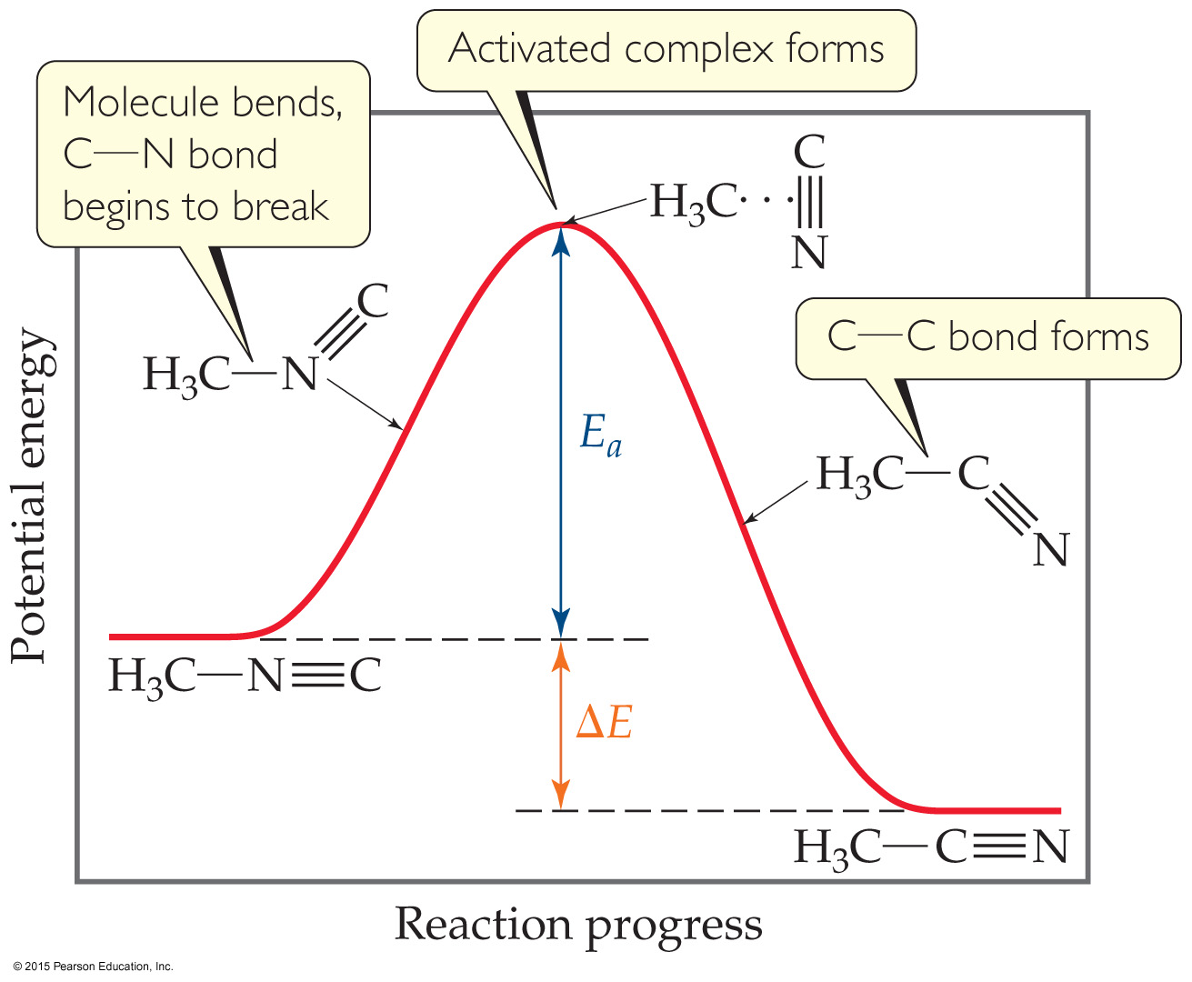
Reaction Progress
Plots are made to show the energy possessed by the particles as the reaction proceeds.
At the highest energy state, the transition state is formed.
Reactions can be endothermic or exothermic after this.

Slide 67


The Relationship Between Activation Energy & Temperature
Arrhenius noted relationship between activation energy and temperature: k = Ae^{−Ea/RT}
Activation energy can be determined graphically by reorganizing the equation: ln k = −E_{a}/RT + ln A

Slide 68
Law vs. Theory
Kinetics gives what happens. We call the description the rate law.
Why do we observe that rate law? We explain with a theory called a mechanism.
A mechanism is a series of stepwise reactions that show how reactants become products.

Slide 69
Reaction Mechanisms
Reactions may occur all at once or through several discrete steps.
Each of these processes is known as an elementary reaction or elementary process.

Slide 70

Molecularity
The molecularity of an elementary reaction tells how many molecules are involved in that step of the mechanism.

Slide 71
Termolecular?
Termolecular steps require three molecules to simultaneously collide with the proper orientation and the proper energy.
These are rare, if they indeed do occur.
These must be slower than unimolecular or bimolecular steps.
Nearly all mechanisms use only unimolecular or bimolecular reactions.

Slide 72

What Limits the Rate?
The overall reaction cannot occur faster than the slowest reaction in the mechanism.
We call that the rate-determining step.

Slide 73
What is Required of a Plausible Mechanism?
The rate law must be able to be devised from the rate-determining step.
The stoichiometry must be obtained when all steps are added up.
Each step must balance, like any equation.
All intermediates are made and used up.
Any catalyst is used and regenerated.

Slide 74
A Mechanism With a Slow Initial Step
Overall equation: NO₂ + CO → NO + CO₂
Rate law: Rate = k [NO₂]²
If the first step is the rate-determining step, the coefficients on the reactants side are the same as the order in the rate law!
So, the first step of the mechanism begins:
NO₂ + NO₂ →

Slide 75
A Mechanism With a Slow Initial Step (continued)
The easiest way to complete the first step is to make a product:
NO₂ + NO₂ → NO + NO₃
We do not see NO₃ in the stoichiometry, so it is an intermediate, which needs to be used in a faster next step.
NO₃ + CO → NO₂ + CO₂

Slide 76
A Mechanism With a Slow Initial Step (completed)
Since the first step is the slowest step, it gives the rate law.
If you add up all of the individual steps (2 of them), you get the stoichiometry.
Each step balances.
This is a plausible mechanism.

Slide 77
A Mechanism With a Fast Initial Step
Equation for the reaction:
2 NO + Br₂ ⇌ 2 NOBr
The rate law for this reaction is found to be
Rate = k [NO]² [Br₂]
Because termolecular processes are rare, this rate law suggests a multistep mechanism.

Slide 78
A Mechanism With a Fast Initial Step (continued)
The rate law indicates that a quickly established equilibrium is followed by a slow step.
Step 1: NO + Br₂ ⇌ NOBr₂
Step 2: NOBr₂ + NO → 2 NOBr

Slide 79
What is the Rate Law?
The rate of the overall reaction depends upon the rate of the slow step.
The rate law for that step would be
Rate = k₂[NOBr₂] [NO]
But how can we find [NOBr₂]?

Slide 80
[NOBr₂] (An Intermediate)?
NOBr₂ can react two ways:
With NO to form NOBr.
By decomposition to reform NO and Br₂.
The reactants and products of the first step are in equilibrium with each other.
For an equilibrium (as we will see in the next chapter):
Rate_{f} = Rate_{r}

Slide 81
The Rate Law (Finally!)
Substituting for the forward and reverse rates:
k₁ [NO] [Br₂] = k₋₁ [NOBr₂]
Solve for [NOBr₂], then substitute into the rate law:
Rate = k₂ (k₁/k₋₁) [NO] [Br₂] [NO]
This gives the observed rate law!
Rate = k [NO]² [Br₂]

Slide 82


Slide 83

Catalysts
Catalysts increase the rate of a reaction by decreasing the activation energy of the reaction.
Catalysts change the mechanism by which the process occurs.

Slide 84
Types of Catalysts
Homogeneous catalysts
Heterogeneous catalysts
Enzymes

Slide 85

Homogeneous Catalysts
The reactants and catalyst are in the same phase.
Many times, reactants and catalyst are dissolved in the same solvent, as seen below.

Slide 86

Heterogeneous Catalysts
The catalyst is in a different phase than the reactants.
Often, gases are passed over a solid catalyst.
The adsorption of the reactants is often the rate-determining step.

Slide 87
Lecture Presentation
Chapter 15 Chemical Equilibrium

Slide 88

The Concept of Equilibrium
As a system approaches equilibrium, both the forward and reverse reactions are occurring.
At equilibrium, the forward and reverse reactions are proceeding at the same rate.
Once equilibrium is achieved, the amount of each reactant and product remains constant.

Slide 89
Comparing Rates
For the forward reaction N₂O₄(g) → 2 NO₂(g)
The rate law is Rate = k_{f} [N₂O₄]
For the reverse reaction 2 NO₂(g) → N₂O₄(g)
The rate law is Rate = k_{r} [NO₂]²

Slide 90


The Equilibrium Constant
Consider the generalized reaction
a A + b B ⇌ d D + e E
The equilibrium expression for this reaction would be
Also, since pressure is proportional to concentration for gases in a closed system, the equilibrium expression can also be written
Notes:
Denorminator/numerator

Slide 91
The Direction of the Chemical Equation and K
The equilibrium constant of a reaction in the reverse reaction is the reciprocal of the equilibrium constant of the forward reaction:
[NO₂]²
[N₂O₄]
N₂O₄(g)
2 NO₂(g)
K_{c} = = 0.212 at 100 °C
⇌
2 NO₂(g)
⇌
N₂O₄(g)
[N₂O₄]
[NO₂]²
K_{c} = = 4.72 at 100 °C

Slide 92
Stoichiometry and Equilibrium Constants
To find the new equilibrium constant of a reaction when the equation has been multiplied by a number, simply raise the original equilibrium constant to that power. Here, the stoichiometry is doubled; the constant is the squared!
[NO₂]²
[N₂O₄]
N₂O₄(g)
⇌
2 NO₂(g)
K_{c} = = 0.212 at 100 °C
[NO₂]⁴
[N₂O₄]²
2 N₂O₄(g)
⇌
4 NO₂(g)
K_{c} = = (0.212)² at 100 °C

Slide 93

Magnitude of K
If K>>1, the reaction favors products; products predominate at equilibrium.
If K<<1, the reaction favors reactants; reactants predominate at equilibrium.

Slide 94



Comparing Q and K
Nature wants Q = K.
If Q < K, nature will make the reaction proceed to products.
If Q = K, the reaction is in equilibrium.
If Q > K, nature will make the reaction proceed to reactants.

Slide 95

LeChâtelier’s Principle
“If a system at equilibrium is disturbed by a change in temperature, pressure, or the concentration of one of the components, the system will shift its equilibrium position so as to counteract the effect of the disturbance.”

Slide 96

Change in Volume or Pressure
When gases are involved in an equilibrium, a change in pressure or volume will affect equilibrium:
Higher volume or lower pressure favors the side of the equation with more moles (and vice-versa).

Slide 97
Lecture Presentation
Chapter 16 Acid–Base Equilibria
© 2015 Pearson Education, Inc.

Slide 98
Lewis Acid/Base Chemistry
Lewis acids are electron pair acceptors.
Lewis bases are electron pair donors.
All Brønsted–Lowry acids and bases are also called Lewis acids and bases.
There are compounds which do not meet the Brønsted–Lowry definition which meet the Lewis definition.
Arrhenius
An acid is a substance that, when dissolved in water, increases the concentration of hydrogen ions.
A base is a substance that, when dissolved in water, increases the concentration of hydroxide ions.
Brønsted–Lowry
An acid is a proton donor.
A base is a proton acceptor

Slide 99

Conjugate Acids and Bases
The term conjugate means “joined together as a pair.”
Reactions between acids and bases always yield their conjugate bases and acids.
Notes:
Nitrous acid

Slide 100
Ion Product Constant
The equilibrium expression for this process is
K_{c} = [H₃O⁺][OH⁻]
This special equilibrium constant is referred to as the ion product constant for water, K_{w}.
At 25 °C, K_{w} = 1.0 × 10⁻¹⁴

Slide 101
Relating pH and pOH
Because
[H₃O⁺][OH⁻] = K_{w} = 1.0 × 10⁻¹⁴
we can take the –log of the equation
–log[H₃O⁺] + –log[OH⁻] = –log K_{w} = 14.00
which results in
pH + pOH = pK_{w} = 14.00

Slide 102
Strong Acids
You will recall that the seven strong acids are HCl, HBr, HI, HNO₃, H₂SO₄, HClO₃, and HClO₄.
These are, by definition, strong electrolytes and exist totally as ions in aqueous solution; e.g.,
HA + H₂O → H₃O⁺ + A–
So, for the monoprotic strong acids,
[H₃O⁺] = [acid]
Notes:
Chloric acid perchloric acid

Slide 103

Weak Acids
For a weak acid, the equation for its dissociation is
HA(aq) + H₂O(l) ⇌ H₃O⁺(aq) + A–(aq)
Since it is an equilibrium, there is an equilibrium constant related to it, called the acid-dissociation constant, K_{a}:K_{a} = [H₃O⁺][A–] / [HA]
The greater the value of K_{a}, the stronger is the acid.

Slide 104
Calculating K_{a} from the pH
The pH of a 0.10 M solution of formic acid, HCOOH, at 25 °C is 2.38. Calculate K_{a} for formic acid at this temperature.
We know that
[H₃O⁺][HCOO–]
[HCOOH]
K_{a} =
To calculate K_{a}, we need the equilibrium concentrations of all three things.
We can find [H₃O⁺], which is the same as [HCOO–], from the pH.
[H₃O⁺] = [HCOO–] = 10^{–2.38} = 4.2 × 10^{–3}
Notes:
secrete

Slide 105
Calculating K_{a} from pH
Now we can set up a table for equilibrium concentrations. We know initial HCOOH (0.10 M) and ion concentrations (0 M); we found equilibrium ion concentrations (4.2 × 10^{–3} M); so we calculate the change, then the equilibrium HCOOH concentration.
 | [HCOOH], M | [H₃O⁺], M | [HCOO⁻], M
Initially | 0.10 | 0 | 0
Change | −4.2 × 10⁻³ | +4.2 × 10⁻³ | +4.2 × 10⁻³
At equilibrium | 0.10 − 4.2 × 10⁻³ = 0.0958 = 0.10 | 4.2 × 10⁻³ | 4.2 × 10⁻³

Slide 106
Example
Calculate the pH of a 0.30 M solution of acetic acid, HC₂H₃O₂, at 25 °C.
HC₂H₃O₂ + H₂O ⇌ H₃O⁺ + C₂H₃O₂–
K_{a} = [H₃O⁺][C₂H₃O₂–] / [HC₂H₃O₂]
 | CH₃COOH (M) | H₃O⁺ (M) | CH₃COO– (M)
Initial Concentration (M) | 0.30 | 0 | 0
Change in Concentration (M) | –x | +x | +x
Equilibrium Concentration (M) | 0.30 – x | x | x

Slide 107
Example (concluded)
K_{a} = [H₃O⁺][C₂H₃O₂–] / [HC₂H₃O₂]
= (x)(x) / (0.30 – x)
If we assume that x << 0.30, then 0.30 – x becomes 0.30. The problem becomes easier, since we don’t have to use the quadratic formula to solve it.
K_{a} = 1.8 × 10^{–5} = x² / 0.30, so x = 2.3 × 10^{–3}
x = [H₃O⁺], so pH = –log(2.3 × 10^{–3}) = 2.64

Slide 108
Anions
Anions of strong acids are neutral. For example, Cl– will not react with water, so OH– can’t be formed.
Anions of weak acids are conjugate bases, so they create OH– in water; e.g., C₂H₃O₂– + H₂O ⇌ HC₂H₃O₂ + OH–
Protonated anions from polyprotic acids can be acids or bases: If K_{a} > K_{b,} the anion will be acidic; if K_{b} > K_{a}, the anion will be basic.

Slide 109
Cations
Group I or Group II (Ca²⁺, Sr²⁺, or Ba²⁺) metal cations are neutral.
Polyatomic cations are typically the conjugate acids of a weak base (NH₃); e.g., NH₄⁺.
Transition and post-transition metal cations are acidic. Why? (There are no H atoms in these cations!) hydrolysis.

Slide 110


Hydrated Cations
Transition and post-transition metals form hydrated cations.
The water attached to the metal is more acidic than free water molecules, making the hydrated ions acidic.

Slide 111
Factors that Affect Acid Strength
H—A bond must be polarized with δ+ on the H atom and δ– on the A atom
Bond strength: Weaker bonds can be broken more easily, making the acid stronger.
Stability of A–: More stable anion means stronger acid.

Slide 112

Oxyacids
Oxyacids consist of H, O, and one other element, which is a nonmetal.
Generally, as the electronegativity of the nonmetal increases, the acidity increases for acids with the same structure.

Slide 113


Comparing Ammonia’s Reaction with H⁺ and BF₃

Slide 114
Lecture Presentation
Chapter 17 Additional Aspects of Aqueous Equilibria
James F. Kirby
Quinnipiac University
Hamden, CT
© 2015 Pearson Education, Inc.

Slide 115

Effect of Acetate on the Acetic Acid Equilibrium
Acetic acid is a weak acid:
CH₃COOH(aq) ⇌ H⁺(aq) + CH₃COO–(aq)
Sodium acetate is a strong electrolyte:
NaCH₃COO(aq) → Na⁺(aq) + CH₃COO–(aq)
The presence of acetate from sodium acetate in an acetic acid solution will shift the equilibrium, according to LeChâtelier’s Principle:
CH₃COOH(aq) ⇌ H⁺(aq) + CH₃COO–(aq)

Slide 116

Buffers
Solutions of a weak conjugate acid–base pair that resist drastic changes in pH are called buffers.
These solutions contain relatively high concentrations (10^{–3} M or more) of both the acid and base. Their concentrations are approximately equal.

Slide 117

How a Buffer Works
Adding a small amount of acid or base only slightly neutralizes one component of the buffer, so the pH doesn’t change much.

Slide 118
Calculating the pH of a Buffer
For a weak acid: K_{a} = [H⁺][A–]/[HA]
Take –log of both sides:
–log K_{a} = –log[H⁺] + –log([A–]/[HA])
Rearrange:
–log[H⁺] = –log K_{a} +log([A–]/[HA])
Which is:
pH = pK_{a} + log([A–]/[HA])
This equation is known as the Henderson–Hasselbalch equation. This applies only to buffers.
Notes:
We can ignore the amounts of acid and base components of the buffer that ionize

Slide 119

Example
A buffer is made by adding 0.300 mol HC₂H₃O₂ and 0.300 mol NaC₂H₃O₂ to enough water to make 1.00 L of solution. Calculate the pH after 0.020 mol of NaOH is added.
 | [CH₃COOH] | [OH–] | [CH₃COO–]
Before reaction (mol) | 0.300 | 0.020 | 0.300
Change (mol) | –0.020 | –0.020 (LR) | +0.020
After reaction (mol) | 0.280 | 0 | 0.320

Slide 120
Solubility Product
For example:
BaSO₄(s) ⇌ Ba²⁺(aq) + SO₄^{2–}(aq)
The equilibrium constant expression is
K_{sp} = [Ba²⁺][SO₄²⁻]
Another example:
Ba₃(PO₄)₂(s) ⇌ 3 Ba²⁺(aq) + 2 PO₄^{3–}(aq)
The equilibrium constant expression is
K_{sp} = [Ba²⁺]³[PO₄³⁻]²

Slide 121

Factors Affecting Solubility
The Common-Ion Effect
If one of the ions in a solution equilibrium is already dissolved in the solution, the solubility of the salt will decrease.
If either calcium ions or fluoride ions are present, then calcium fluoride will be less soluble.

Slide 122

Factors Affecting Solubility
pH: If a substance has a basic anion, it will be more soluble in an acidic solution.
Remember that buffers control pH. When a buffer is used, there is no change in concentration of hydroxide ion!

